Slide 1


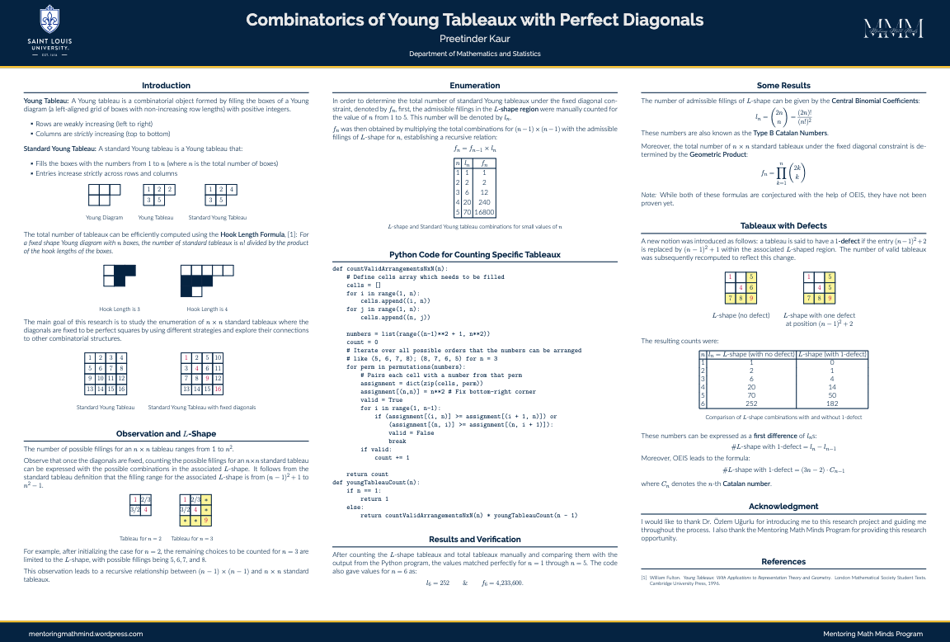
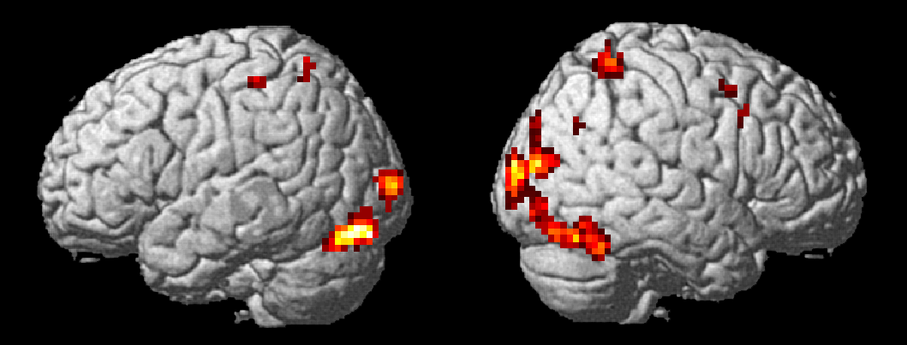
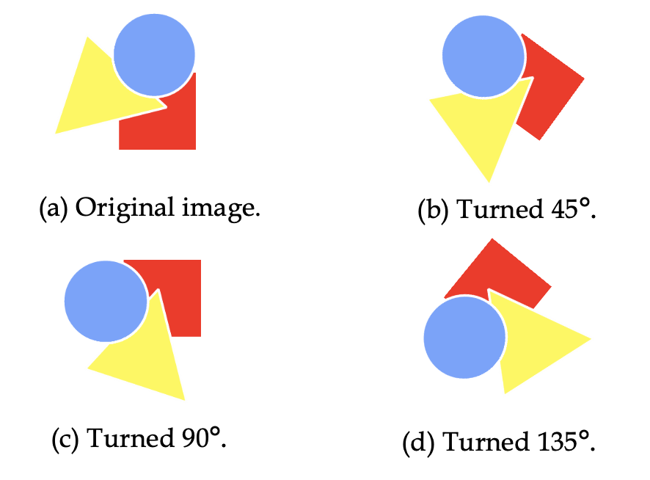
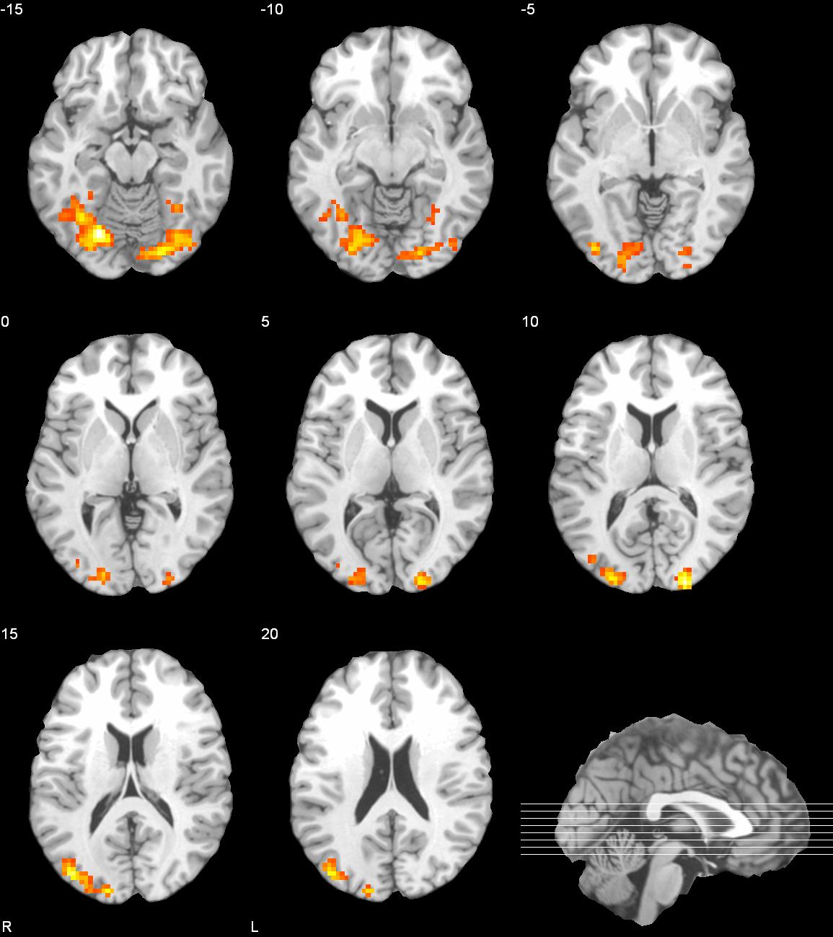
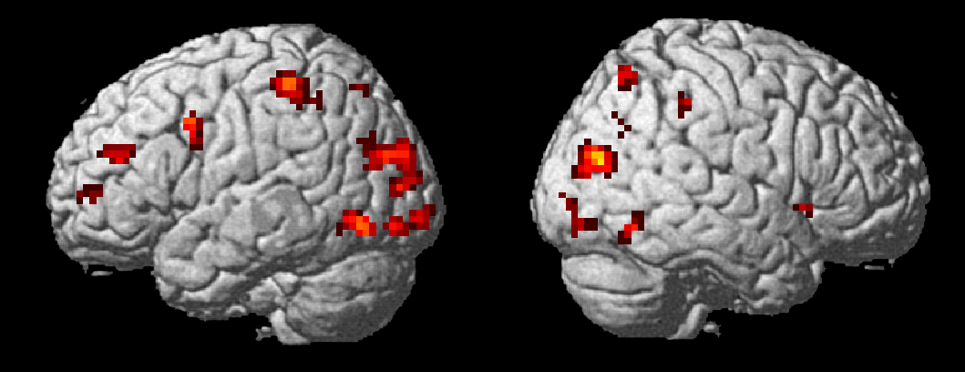
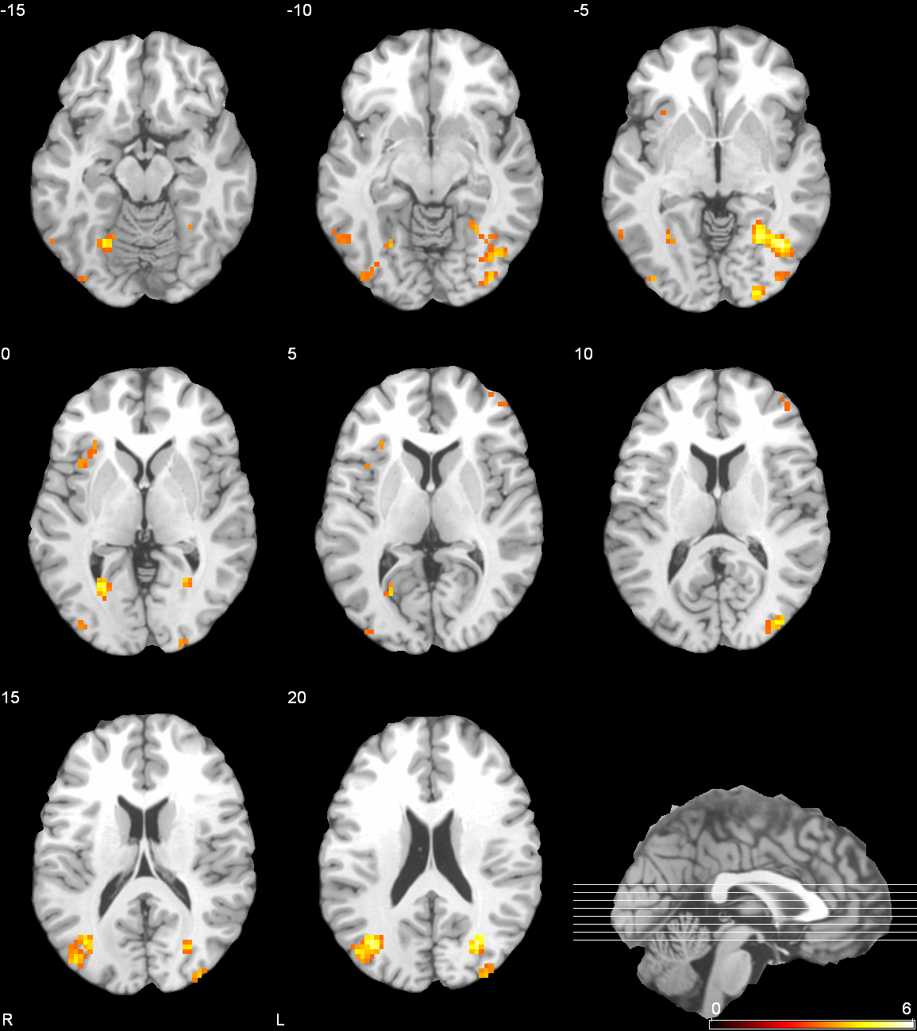
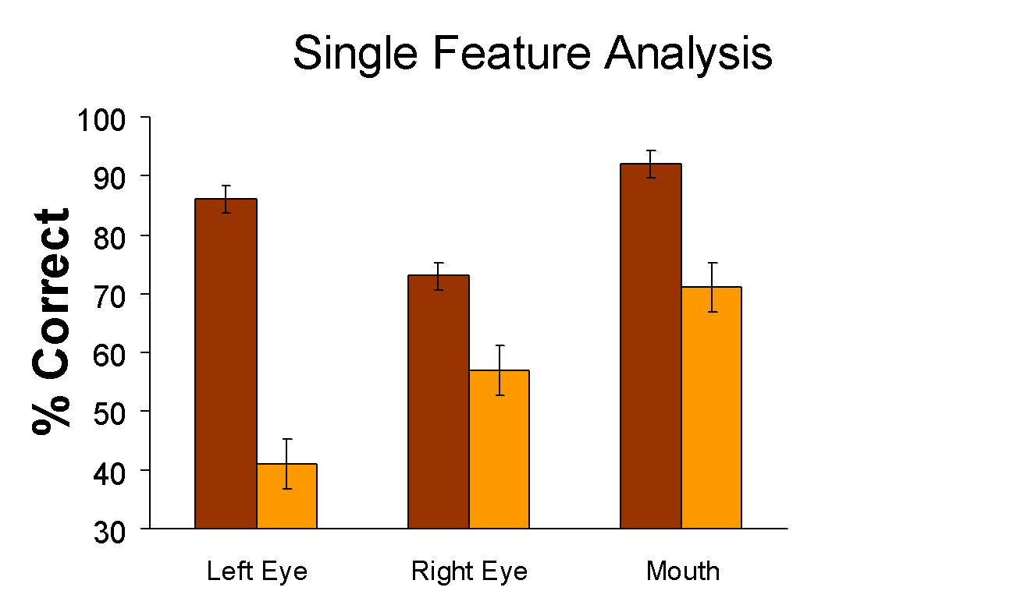
Putting Together a Poster for Poster Session
NAMES
Affiliation
Overview/Introduction
vfv
Results
More Visual if Needed
Conclusion
Describe the basics about your thesis or project here - briefly! An image such as Figure 1 can help jazz up the introduction and get people interested in your poster.
Figure 1: What a Great Poster!
It’s important to give your reader a reason to keep reading your poster, why should they care about your project? Tell them!
Here we have the real meat of the poster. Talk about what you did, how it worked out, and how it could have gone better. Diagrams and images - charts, graphs, photographs - are all good things to include here.
Thatcher > Normal
Rather than just a summary of your findings (which you presented in the previous section), write your conclusions based on those results;
what have you learned, and
what does what you’ve learned mean for your reader, the world at large, and
your future research?
Figure 2: Small multiples
Formatting References
As usual, you want to cite anything that you have taken from other sources and provide the details here. You can just put them in an itemized list.
References
Sample scientific poster. Online; viewed 2011 September 14. URL: . Purrington, Colin. 2011a.
Designing conference posters. Online; viewed 2011 September 14. URL:
Materials and Methods
Inverted > Upright
Some basic information about how you went about doing your research. You might want to have some images here that show some of your equipment, your lab setup, or some other relevant things. (For example, for a project on image processing, you might have a “before” and “after” image.)
Use itemized lists rather than full paragraphs of text
Remember, people are supposed to be intrigued by your poster
The details should be in your full report or thesis
Tell them how to get those (if they can) at the end of the poster
Sometimes you need (or want) to include more than one image in a figure, such as when you have several close variations on a single image, as shown in Figure 2, which has subfigures a or (b). You could also refer to the subfigures as Figure 2c or Figure 2(d).
Figure 3: More
For Further Information
Possibly the most important section of your poster! Tell people how they can find out more about your research. Be sure to
include
Your e-mail address.
A URL for a website with more information. https://stars-slu.github.io/homepage/
If possible, a URL where they can download and read your full report.
A URL where they can download your poster. And, again, the same URL will do.
Or QR code of the URL, if possible
Acknowledgments
If there are people that were particularly helpful to you during the program, thank them here.
It’s especially important to mention anyone who gave you money. I want to express my appreciation to the Mathematical Association of America and the Tensor Foundation which supported this program.
The Statistics and Research Summer Program at Saint Louis University (STARS@SLU 2026)
https://stars-slu.github.io/homepage/

